Slide 1
Lecture 4

Slide 2
Question 14.4.1
In which state of matter are the atoms that make up the matter most tightly bound by electrical forces?
Solid
Liquid
Gas
Plasma

Slide 3
m
m
m
m
m
m
m
m
m
m
m
m
m
m
m
m
m
m
m
m
m
m
m
m

Slide 4
m
m
m
m
m
m
m
m
m
m
m
m
m
m
m
m
m
m

Slide 5
m
m
m
m
m
m
m

Slide 6
m
m
m
m
m
m

Slide 7
Fluid Mechanics
Fluids: Randomly arranged collections of molecules
Gases
Liquids
Solids?
No shearing stresses
No Tensile stresses

Slide 8
Question 123.4.2
Suppose you are standing directly behind someone who steps back and accidentally stomps on your foot with the heel of one shoe. Would you be better off if that person were
(a) a large professional basket ball player wearing sneakers
(b) a petite woman wearing spike-heeled shoes?

Slide 9
Question 123.4.3
Consider what happens when you push both a pin and the blunt end of a pen against your skin with the same force. What will determine whether your skin will be punctured?
a) the pressure on your skin
b) the net applied force on your skin
c) both pressure and net applied force are equivalent
d) neither pressure nor net applied force are relevant here
G

Slide 10
Problem
A 50.0kg woman balances on one heel of a pair of high heeled shoes. If the heel is circular and has a radius of 0.5000cm , what pressure does she exert on the floor?

Slide 11
Problem
How much larger is the pressure at the bottom of a swimming pool than the pressure at the pool surface?

Slide 12
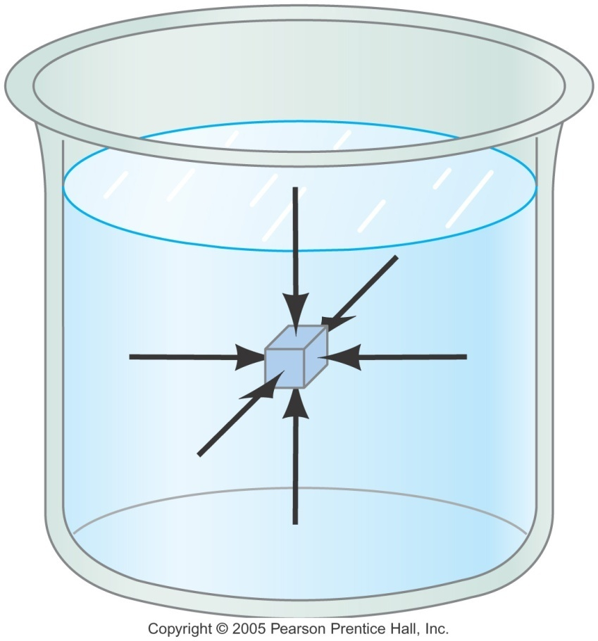
Pressure
P is Scalar quantity
SI Unit is the Pascal

Slide 13
Question 123.4.4
You are walking out on a frozen lake and you begin to hear the ice cracking beneath you. What is your best strategy for getting off the ice safely?
a) stand absolutely still and don’t move a muscle
b) jump up and down to lessen your contact time with the ice
c) try to leap in one bound to the bank of the lake
d) shuffle your feet (without lifting them) to move towards shore
e) lie down flat on the ice and crawl toward shore
G

Slide 14
Question 123.4.5
Two dams are exactly the same size (same width and depth). One (A) holds back a large lake, the other (B) holds back a small river. Which Dam has to be built stronger?
A
B
Neither, they should be the same
A
To Sugar City
Dam
B

Slide 15
Question 123.4.9
When a hole is made in the side of a can holding fluid, the fluid flows out of the hole. The path the water follows is shown in the picture. If the container is dropped in free fall, the water flow will:
a) diminish
b) stop altogether
c) go out in a straight line
d) curve upwards

Slide 16
Question 123.4.6
Which has a greater force do to the fluid acting on the base?
A B
Hint: Which has a greater total weight?
Lead

Slide 17
Pressure and Depth (2 of 3)
F_{pt}
F_{pml}
-F_{pmr}
If we use our new definition of pressure
F_{pb}
W
Sides
-P_{o}Aĵ
Top
P_{m}A x
-P_{m}A x
Bottom
PAĵ
Mg

Slide 18
Pressure and Depth (3 of 3)
Substitution yields:
So we find that the pressure as a function of depth is given by
If we start at the surface,
-P_{o}Aĵ
d
d+h
PAĵ
Mg

Slide 19
Pascal’s Law
If we change P_{o}, there must be a change in pressure throughout the entire fluid!
Pascal’s Law: a change in the pressure applied to a fluid is transmitted undiminished to every point of the fluid and to the walls of the container.

Slide 20
Question 123.4.7
Three containers are filled with water to the same height and have the same surface area at the base, but the total weight of water is different for each. Which container has the greatest total force acting on its base?
a) container 1
b) container 2
c) container 3
d) all three are equal
1
2
3

Slide 21
Question 123.4.8
How do Hydraulic Brakes Work?
A) The pressure due to the pedal being depressed compresses the fluid which then causes a force on the the brake pads
B) The force due to the pedal being depressed increases the pressure which is transmitted equally to the entire system, and causes a force on the brake pads
C) The force on the pedal causes a change in volume of the master cylinder which, in turn, causes there to be a higher pressure in the brake cylinder than exists in the master cylinder. This higher pressure causes a force on the brake pads

Slide 22
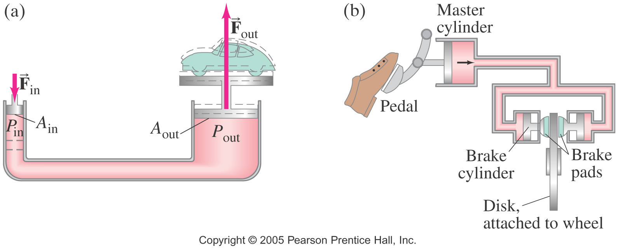
Question 123.4.8
How do Hydraulic Brakes Work?
A) The pressure due to the pedal being depressed compresses the fluid which then causes a force on the the brake pads
B) The force due to the pedal being depressed increases the pressure which is transmitted equally to the entire system, and causes a force on the brake pads
C) The force on the pedal causes a change in volume of the master cylinder which, in turn, causes there to be a higher pressure in the brake cylinder than exists in the master cylinder. This higher pressure causes a force on the brake pads

Slide 23
Problem
We push down on the small piston on the left. The pressure changes by an amount ΔP. How much does the pressure change in the right hand side of this jack?

Slide 24
Problem
We push down on the small piston on the left. The pressure changes by an amount ΔP. What is the upward force in the right hand side of the jack?

Slide 25
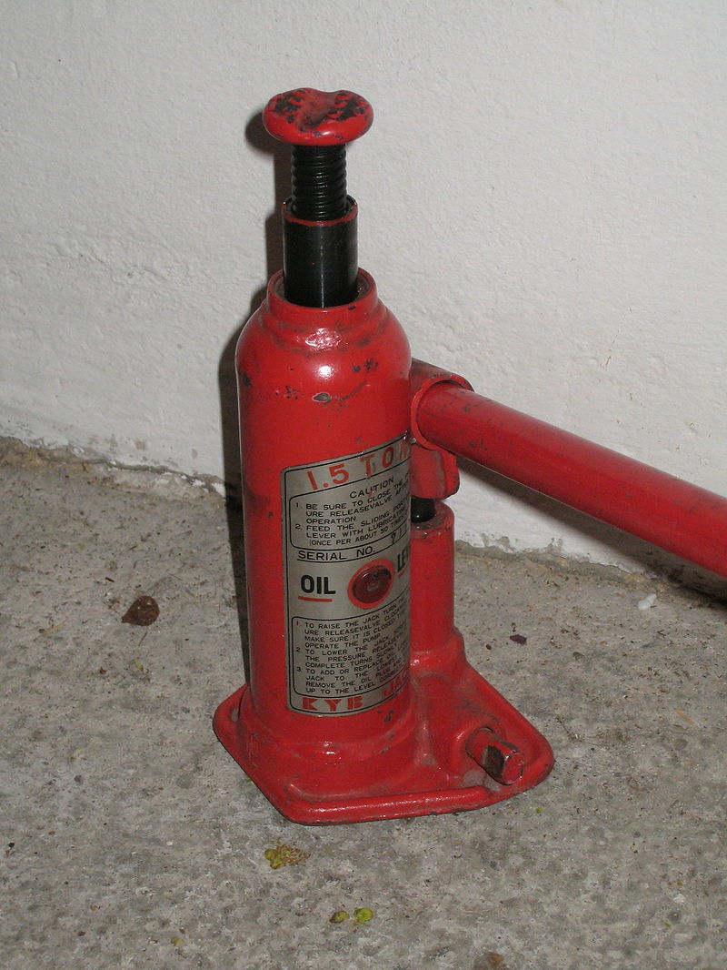
Small Cylinder
Big Cylinder

